Slide 1
HackWave
Sreenidhi Institute Of Science And Technology (SNIST), Hyderabad
SMART BLIND ASSISTING
SHOE
BY : Saranya Shree R S
Sai Samicsha Shri D Madan Prakash K S Pragadhiswari P
Team Name : Power House
EEE 2nd Year , Chennai Institute Of Technology

Slide 2

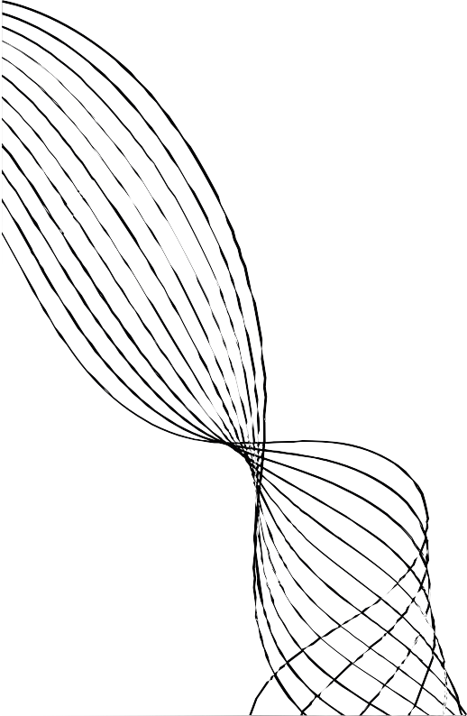
PROBLEM STATEMENT
Open Innovation
Visually impaired individuals often face difficulties in navigating their surroundings safely, relying on traditional aids like canes that offer limited awareness of obstacles and dangers. These tools do not provide real-time alerts or emergency assistance, which can compromise their safety. There is a need for a smart solution that enhances environmental awareness, delivers tactile feedback for immediate dangers, and provides emergency communication.

Slide 3


EXISTING SOLUTION
Existing solutions for assisting the visually impaired are usually l imited to basic tools l ike white canes or simple wearable bands with buzzers. Some of these devices use ultrasonic sensors to detect obstacles but offer only minimal feedback, such as vibration or sound alerts, without additional
features l ike GPS tracking or environmental monitoring. These solutions
often lack integration with multiple technologies and are not designed to provide comprehensive assistance, making them less effective in real-
time emergency situations. This leaves room for more innovative solutions l ike the Smart Blind Assisting Shoe, which offers a more holistic approach.

Slide 4

PROPOSED SOLUTION
The Smart Blind Assisting Shoe integrates an ultrasonic sensor with Arduino to detect obstacles within 15 cm, triggering a buzzer, vibrator, and LED for alerts. It features an OLED display for feedback, a GPS module for location tracking, and a GSM module to send emergency alerts when the touch sensor is activated.
Additionally, it monitors environmental changes using humidity and temperature sensors, notifying users about shifts in weather. By mapping the user's movement (abscissa) with GPS, it ensures real-time assistance and safety, all seamlessly integrated into a wearable shoe.
Links of our Proposed Solution
CODE VIDEO
CIRCUIT DIAGRAM AND FLOW DIAGRAM
Pictures of the prototype

Slide 5


TECH STACK
Ultrasonic Sensor – Detects obstacles within 15 cm.
Arduino Board – Acts as the central controller for all components.
Buzzer, Vibrator, and LED – Provide alerts through sound, vibration, and light.
OLED Display – Displays feedback to the user.
Touch Sensor – Activates emergency alerts when pressed.
GSM Module – Sends emergency messages or calls to guardians.
GPS Module – Tracks the user’s location for assistance.
Humidity and Temperature Sensors – Monitor environmental conditions.
Battery – Powers the entire system.
Shoe Base – Integrates all components into a wearable design.

Slide 6
BENEFITS
Enhanced Obstacle Detection and Directional Alerts
SOS Mode
Emergency Response and Location Tracking 4.Real time distance display on OLED Screen
5. Emergency Response and Location Tracking

